Slide 1
BALL AND BEAM

Slide 2
DEFINITION OF TERMS

Slide 3
Stable System: A system is said to be stable if it produces a bounded output for a given bounded input, that is it’s output is under control.
2)Marginally Stable System: A system is marginally stable if the natural response neither decays or grows but remains constant
3) System Linearization: It involves creating a linear approximation of a non-linear system that is valid in a small region around the operating point. Non- linear systems are systems that do not obey the superposition principle and are often governed by non-linear differential equations

Slide 4
4) PI Controller: A Proportional and Integral Controller is one used to guarantee zero steady state error between the commanded set point and the actual value based on some type of feedback
5)PID Controller: It’s a controller used to produce a control signal that can dynamically reduce the difference between the output and the desired set point of a given system. It is used by control engineers to regulate the temperature, flow, pressure, speed and other process variables.
6) Phase- Lead Controller: Used to increase the phase margin of the system hence improving its stability.

Slide 5
7) Control Objectives : Refers to the specific goal or desired outcome that the control system is designed to achieve .
It acts as a guiding principle for the controllers action, ensuring the system behaves as intended
8) Disturbances: Refers to any unwanted signal or influence that affects the system’s output , potentially interfacing with its ability to achieve its control objectives.

Slide 6
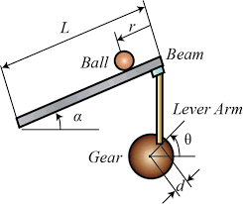
2) Modeling OF THE BALL AND BEAM SYSTEM
Design criteria
Settling time < 3 seconds
Overshoot < 5%

Slide 7
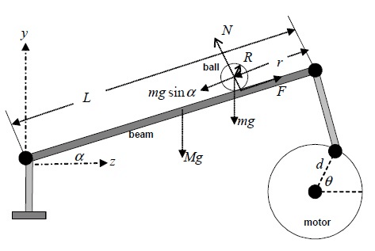
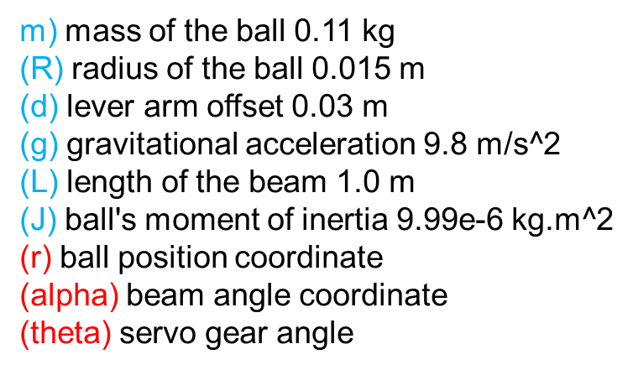
SYSTEM PARAMETERS

Slide 8
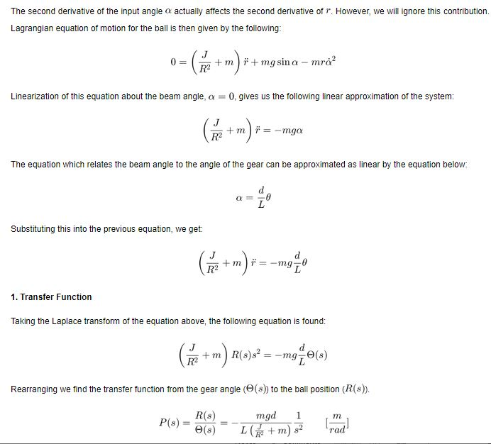
System Equation Build Up

Slide 9

TRANSFER FUNCTION
Mathematical model of the system
$(\frac{J}{R^{2}}+m)\ddot{r}$=-mg$\frac{d}{L}Ѳ$
Taking the laplace transform of the system above, the open loop transfer function is
($\frac{J}{R^{2}}+m)R\left(s\right)s^{2}=−mg\frac{d}{L}θ(s)$
Rearranging the equation, we have (a type 2 system):
$$\frac{Ball position,R(s)}{gear angle,θ(s)}=\frac{R(s)}{θ(s)}=−\frac{mgd}{L\left(\frac{J}{R^{2}}+m\right)}\frac{1}{s^{2}} [\frac{m}{rad}]$$

Slide 10
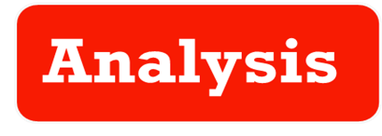

creating a transfer function model in MATLAB
m = 0.111;
R = 0.015;
g = -9.8; L = 1.0;
d = 0.03;
J = 9.99e-6;
s = tf('s’);
P_ball = -m*g*d/L/(J/R^2+m)/s^2;

Slide 11
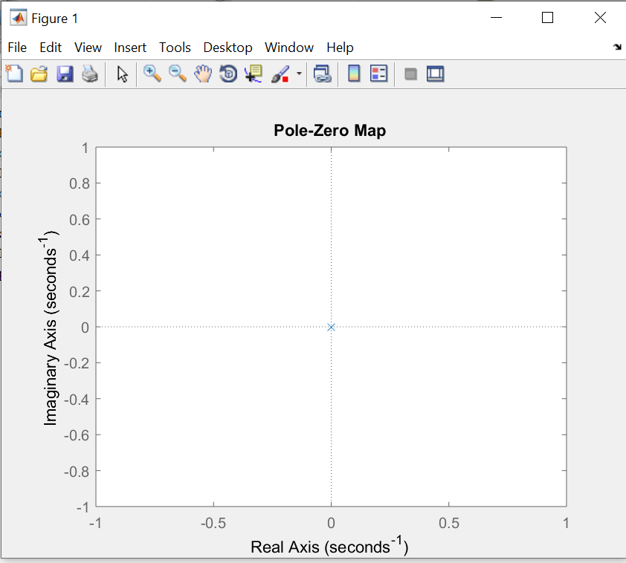
Pole zero plot
Below is the matlab Code
m=0.111; R=0.015; g=9.8; L=1.0
d=0.03; J=9.99e-6;
s=tf(‘s’)
P_ball=-m*g*d/L(J/R^2+m)(s^2);
Pzmap(P_ball);
Step(P_ball);
bode(P_ball);
nyquist(P_ball);
It has two poles in the origin as seen in
The map beside, Since the poles are strictly
In the left hand plane(left of -1+j0 point), the
Open loop system is unstable, Hence the ball
will roll right to the end of the beam

Slide 12
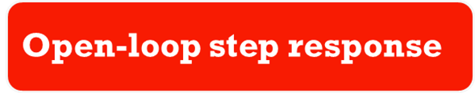
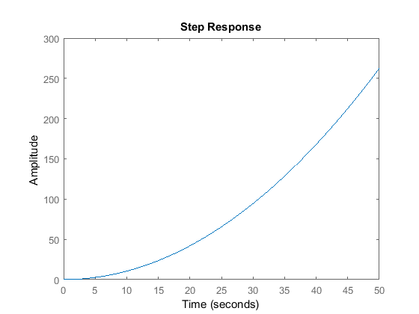
m = 0.111;
R = 0.015;
g = -9.8; L = 1.0;
d = 0.03;
J = 9.99e-6;
s = tf('s’);
P_ball = -m*g*d/L/(J/R^2+m)/s^2
step(P_ball)
From this plot it is clear that the system is unstable in open-loop causing the ball to roll right off the end of the beam. Therefore, some method of controlling the ball's position in this system is required.

Slide 13
CONTROLLER DESIGN
PD CONTOLLER
FREQUENCY

Slide 14
PD CONTROLLER DESIGN

Slide 15

CONTROLLER DESIGN
A PD controller is design to control the system. The Derivative control to reduce the overshoot, The integral control to reduce the steady state error, and proportional control can be used to improve the rise time. The transfer function of a PID Controller is:
C(S)=$K_{P}+\frac{K_{I}}{S}$
In general, the gains of $K_{P},K_{D}$ will need to be adjusted manually by the user/engineer in order to achieve system specifications( ie max overshoot of less than 5% and settling time of less then 3 seconds). Manual tuning of the gain settings is the simplest method for setting the PD controls. First, the derivative and integral gains are set to zero, increase the proportional gain until observing oscillation in the output. After the proportional gain is set, the derivative gain can be increased. Derivative gain will increase the overshoot and decrease settling time slightly. Once the derivative control is set, we can increase the integral gain.

Slide 16
PROPORTIONAL DERIVATIVE CONTROL
To add derivative term to the controller. We use the matlab code below m = 0.111; R = 0.015; g = -9.8; L = 1.0; d = 0.03; J = 9.99e-6; s = tf('s'); P_ball = -m*g*d/L/(J/R^2+m)/s^2; Kp = 10; Kd = 20; C = pid(Kp,0,Kd);
sys_cl=feedback(c*p_ball,1);
Now, we can model the system's response to a step input of 0.25 m. Add the following line of code.
t=0:0.01:5; step(0.25*sys_cl)

Slide 17
CONTROLLER PARAMETERS
Matlab code for controller implementation
m=0.11; R=0.015; g=-9.8; L=1.0; d=0.03; J= 9.99e-6;
s=tf(‘s’);
P_ball= -m*g*d/L/((J/R^2)+m)/s^2;
%PID CONTROLLER DESIGN
Kp = 05;
Kd=05;
C=pid(Kp,0,Kd);
Sys_cl=feedback(C*P_ball,1);
%STEP RESPONSE
t=0:0.01:5;
step(0.25*sys_cl)

Slide 18
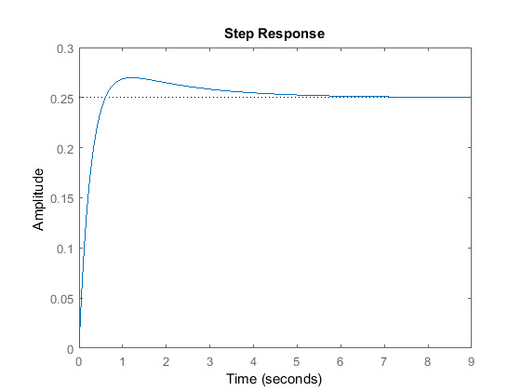
Kd=20
Overshoot criterion is met
Settling time needs to come down a bit
To decrease the settling time we may try increasing the Kp slightly to increase the rise time. The derivative gain Kd can also be increased to take off some of the overshoot that increasing Kp will cause.

Slide 19
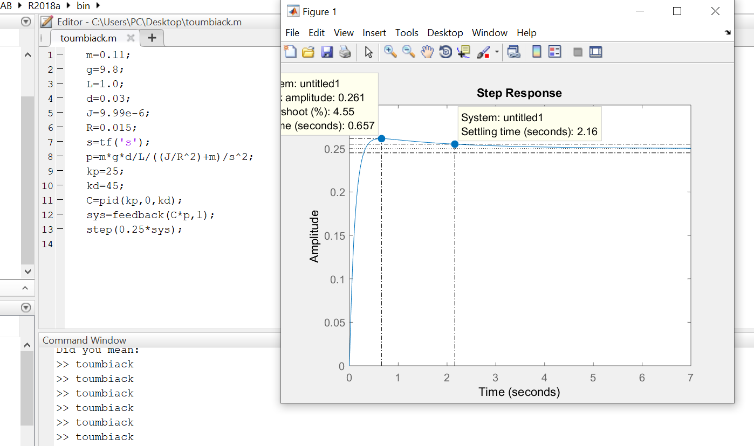

After playing with gains a bit, From the plot the control objectives of settling time less than 3 secs and overshoot less than 5% are met with controller parameter values of
$K_{P}=25$;
$K_{D}=45$;
C = pid(Kp,0,Kd); sys_cl=feedback(c*p_ball,) step(0.25*sys_cl)

Slide 20
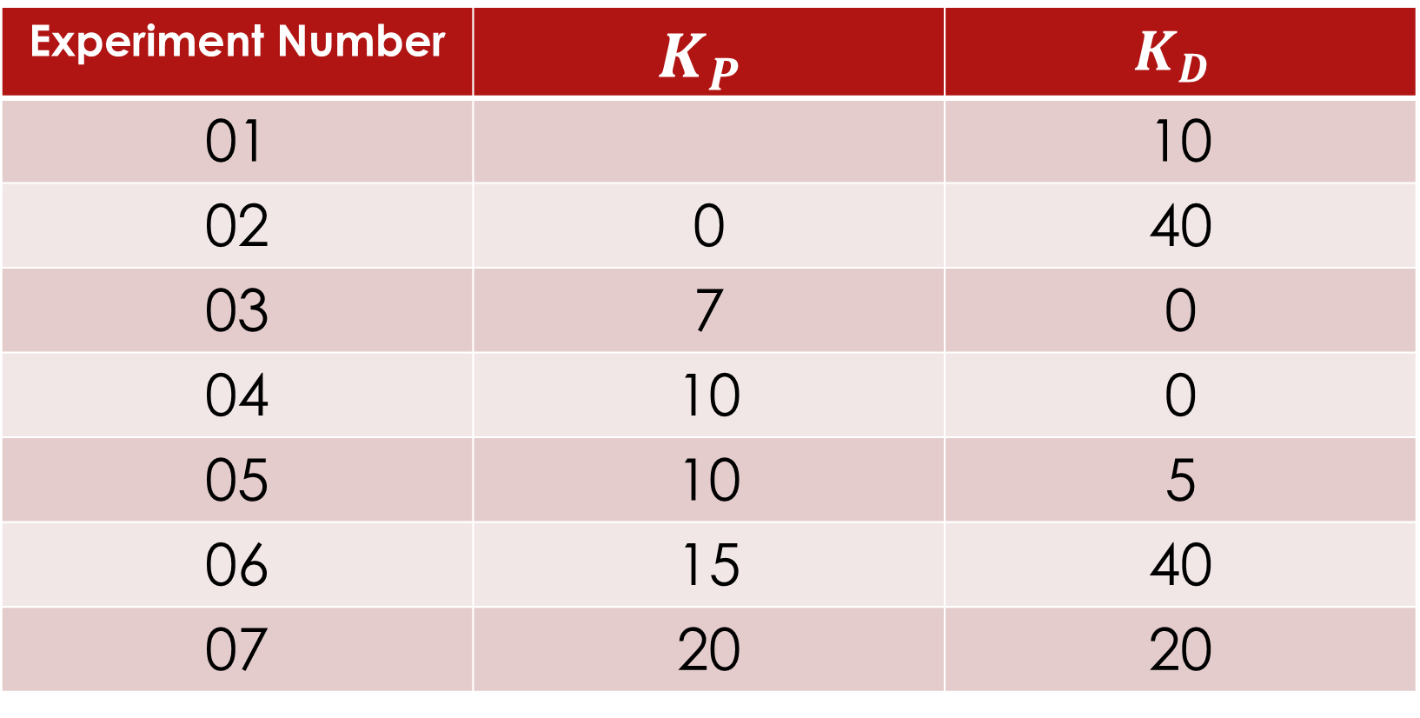
All the parameters had get from manual tunning method shown in table below
Experiment Number | $$K_{P}$$ | $$K_{D}$$
01 |  | 10
02 | 0 | 40
03 | 7 | 0
04 | 10 | 0
05 | 10 | 5
06 | 15 | 40
07 | 20 | 20

Slide 21
FREQUENCY CONTROL
DESIGN

Slide 22
FREQUENCY ANALYSIS( Bode Plot, Polar Plot)
m=0.11; R=0.015; g=-9.8; L=1.0; d=0.03; J= 9.99e-6;
s=tf(‘s’);
P_ball= -m*g*d/L/((J/R^2)+m)/s^2;
bode(P_ball);
nyquist(P_ball);

Slide 23
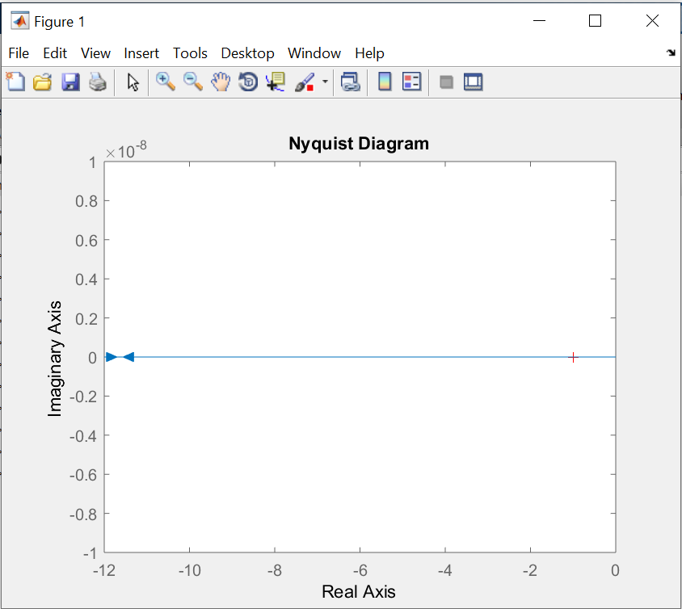
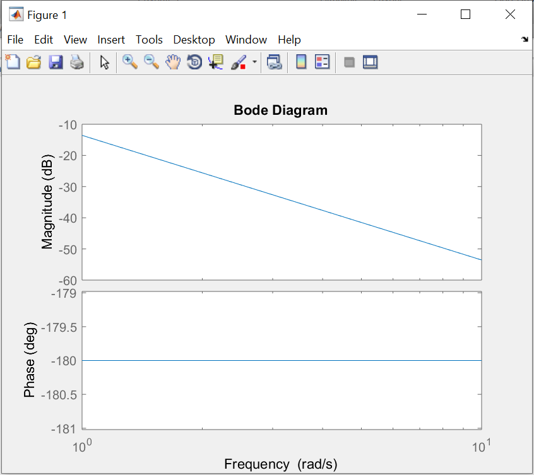
BODE PLOT AND NYQUIST PLOT

Slide 24
Differences between PI, PD AND PID CONTROLLERS
 | P | PI | PD
RISE TIME | increases | Decreases rise time | Decreases rise time
OVERSHOOT | Increase overshoot | Max overshoot decreases | Decreases overshoot
STEADY STATE ERROR(SSE) | high | low | Eliminates SSE
SETTLING TIME | increases | Decreases settling time | Decreases settling time

Slide 25
PREPARED BY
QUINUEL TABOT NDIP
T0UMBIACK DIEUDONNE
MBACHAM LOANA NING
MEWOABI NGUEFACK DORE
ANANFACK ZANGO ANGELA CARIN
OJONG ENYANG OYERE
TABI JOSEPH
ALEANU NTIMAEH ENOW
ASONGNKWELLE COURAGE AYIM
SIRRI THERESIA

